Slide 1
SS ZG622:
Software Project Management
(Risk Analysis & Risk Management)
Prof K G Krishna, BITS-Pilani Off-Campus Centre, Hyderabad

Slide 2


Text Books
T1: Pressman, R.S. Software Engineering : A Practitioner’s Approach, 7th Edition, TMH, 2010
T2: Hughes, B and Cotterel, M., Software Project Management, 11th Edition, TMH, 2011
S1: Frank Tsui, Managing Software Projects, Jones&Bartlett, 2011
S2: Pankaj Jalote, Software Project Management in Practice, Pearson Education, 2002
Note: In order to broaden understanding of concepts as applied to Indian IT industry, students are advised to refer books of their choice and case-studies in their own organizations

Slide 3
Risk Analysis & Risk Management:
Introduction, Concepts & Terminology
PPT Courtesy: Some of the content of this PPT is sourced from slides provided by Software Engineering: A Practitioner’s Approach, 7/e (McGraw-Hill 2009)
Hughes, B and Cotterel, M., Software Project Management, 11th Edition, TMH, 2011
.

Slide 4
Topics
Definition of ‘risk’ and ‘risk management’
Some ways of categorizing risk
Risk management
  Risk identification – what are the risks to a project?
  Risk analysis – which ones are really serious?
  Risk planning – what shall we do?
  Risk monitoring – has the planning worked?

Slide 5
Definitions of ‘risk’
‘The chance of exposure to the adverse consequences of future events’
Project plans have to be based on assumptions
Risk is the possibility that an assumption is wrong
When the risk happens it becomes a problem or an issue

Slide 6
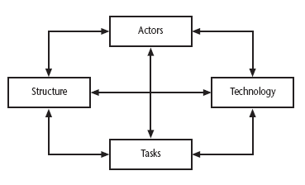
Categories of risk
Notes:
This is based on Lyytinen’s sociotechnical model of risk
Actors relate to all those involved in the project including both developers, users and managers e.g. a risk could be that high staff turnover leads to information of importance to the project being lost
Technology – both that used to implement the project and that embedded in the project deliverables – risk could be that the technologies selected are not in fact appropriate.
Structure – this includes management procedures, risk here is that a group who need to carry out a particular project task are not informed of this need because they are not part of the project communication network
Tasks – the work to be carried out. A typical risk is that the amount of effort needed to carry out the task is underestimated.
A risk could be well belong to more than one of the four areas – for example, estimates being wrong could be influenced by problems with actors (e.g. lack of experience with a technical domain) or the structure (over optimism of managers keen to win work).

Slide 7
Overview
Risks are potential problems that might affect the successful completion of a software project.
Risks involve uncertainty and potential losses.
Risk analysis and management are intended to help a software team understand and manage uncertainty during the development process.
The important thing is to remember that things can go wrong and to make plans to minimize their impact when they do.
The work product is called a Risk Mitigation, Monitoring, and Management Plan (RMMM).

Slide 8
Risk Component & Drivers
Performance risk—the degree of uncertainty that the product will meet its requirements and be fit for its intended use.
Cost risk—the degree of uncertainty that the project budget will be maintained.
Support risk—the degree of uncertainty that the resultant software will be easy to correct, adapt, and enhance.
Schedule risk—the degree of uncertainty that the project schedule will be maintained and that the product will be delivered on time.
The impact of each risk driver on the risk component is divided into one of four impact categories—negligible, marginal, critical, or catastrophic

Slide 9
Risk Management
Reactive
project team reacts to risks when they occur
mitigation—plan for additional resources in anticipation of fire fighting
fix on failure—resource are found and applied when the risk strikes
crisis management—failure does not respond to applied resources and project is in jeopardy
Proactive
formal risk analysis is performed
organization corrects the root causes of risk
  TQM concepts and statistical SQA
  examining risk sources that lie beyond the bounds of the software
  developing the skill to manage change

Slide 10
Risk Check List
Product size (PS)—risks associated with the overall size of the software to be built or modified.
Business impact (BU)—risks associated with constraints imposed by management or the marketplace.
Customer characteristics (CU)—risks associated with the sophistication of the customer and the developer's ability to communicate with the customer in a timely manner.
Process definition (PR)—risks associated with the degree to which the software process has been defined and is followed by the development organization.
Development environment (DE) —risks associated with the availability and quality of the tools to be used to build the product.
Technology to be built (TE)—risks associated with the complexity of the system to be built and the "newness" of the technology that is packaged by the system.
Staff size and experience (ST)—risks associated with the overall technical and project experience of the software engineers who will do the work.

Slide 11
Risk Projection & Building a Risk Table
Risk projection, also called risk estimation, attempts to rate each risk in two ways
- the likelihood or probability that the risk is real and
- the consequences of the problems associated with the risk, should it occur.
The project planner, along with other managers and technical staff, performs four risk projection activities:
    establish a scale that reflects the perceived likelihood of a risk,
    delineate the consequences of the risk,
    estimate the impact of the risk on the project and the product, and
    note the overall accuracy of the risk projection so that there will be no misunderstandings.

Slide 12
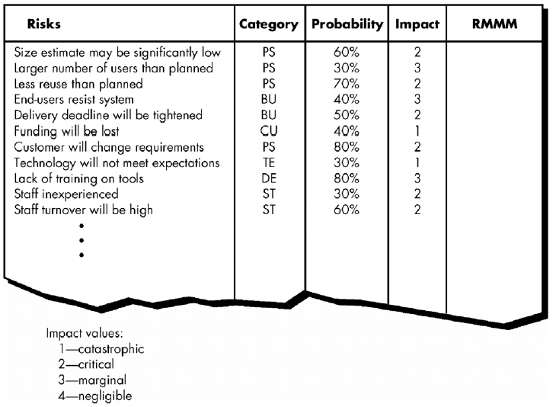
Building Risk Table
RMMM = Risk Mitigation, Monitoring and
Management Plan

Slide 13
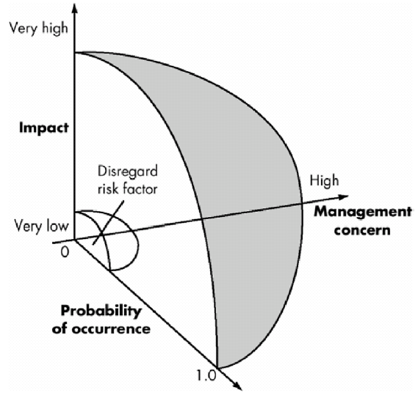
Risk and Management Concern

Slide 14
Assessing Risk Impact
The following steps are recommended to determine the overall consequences of a risk:
  Determine the average probability of occurrence value for each risk component.
  Using table 1 (slide 10) determine the impact for each component based on the criteria shown.
  Complete the risk table and analyze the results
  The overall risk exposure, RE, is determined using the following relationship: RE = P x C
  where P is the probability of occurrence for a risk, and C is the cost to the project should the risk occur.

Slide 15
Example
Assume that the software team defines a project risk in the following manner:
Risk identification. Only 70 percent of the software components scheduled for reuse will, in fact, be integrated into the application. The remaining functionality will have to be custom developed.
Risk probability. 80% (likely).
Risk impact. 60 reusable software components were planned. If only 70 percent can be used, 18 components would have to be developed from scratch (in addition to other custom software that has been scheduled for development). Since the average component is 100 LOC and local data indicate that the software engineering cost for each LOC is $14.00, the overall cost (impact) to develop the components would be 18 x 100 x 14 = $25,200.
Risk exposure. RE = 0.80 x 25,200 ~ $20,200.

Slide 16
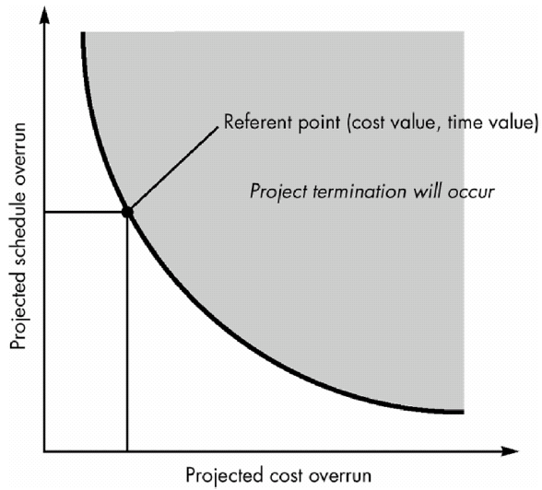
Risk Assessment
For assessment to be useful, a risk referent level must be defined.
In the context of software risk analysis, a risk referent level has a single point, called the referent point or break point, at which the decision to proceed with the project or terminate it (problems are just too great) are equally weighted.

Slide 17
A framework for dealing with risk
The planning for risk includes these steps:
Risk identification – what risks might there be?
Risk analysis and prioritization – which are the most serious risks?
Risk planning – what are we going to do about them?
Risk monitoring – what is the current state of the risk?

Slide 18
Risk identification
Approaches to identifying risks include:
Use of checklists – usually based on the experience of past projects (previous slides)
Brainstorming – getting knowledgeable stakeholders together to pool concerns
Causal mapping – identifying possible chains of cause and effect

Slide 19
Boehm’s top 10 development risks
Risk | Risk reduction techniques
Personnel shortfalls | Staffing with top talent; job matching; teambuilding; training and career development; early scheduling of key personnel
Unrealistic time and cost estimates | Multiple estimation techniques; design to cost; incremental development; recording and analysis of past projects; standardization of methods
Developing the wrong software functions | Improved software evaluation; formal specification methods; user surveys; prototyping; early user manuals
Developing the wrong user interface | Prototyping; task analysis; user involvement
Notes:
Barry Boehm surveyed software engineering project leaders to find out the main risks that they had experienced with their projects. For each risk, some risk reduction techniques has been suggested.

Slide 20
Boehm’s top ten risk – contd.,
Gold plating | Requirements scrubbing, prototyping, design to cost
Late changes to requirements | Change control, incremental development
Shortfalls in externally supplied components | Benchmarking, inspections, formal specifications, contractual agreements, quality controls
Shortfalls in externally performed tasks | Quality assurance procedures, competitive design etc
Real time performance problems | Simulation, prototyping, tuning
Development technically too difficult | Technical analysis, cost-benefit analysis, prototyping , training
Notes:
‘Gold plating‘ refers to inclusion of features that in fact are unnecessary and which end up never actually being used.

Slide 21
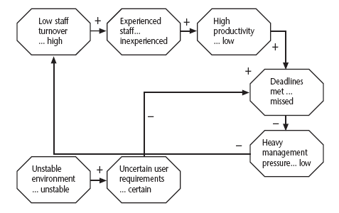
Causal mapping
Notes:
The idea here is to get the major stakeholders together and to brainstorm collectively the things that could go wrong. The causes of the problems identified are traced back using the mapping technique which identifies the project factors ( or ‘concept variables’) that people see as being important and the causal links between them. These links can be positive or negative.
Where possible, for each factor, positive and negative aspects are identified e.g. ‘stable…unstable requirements’.

Slide 22
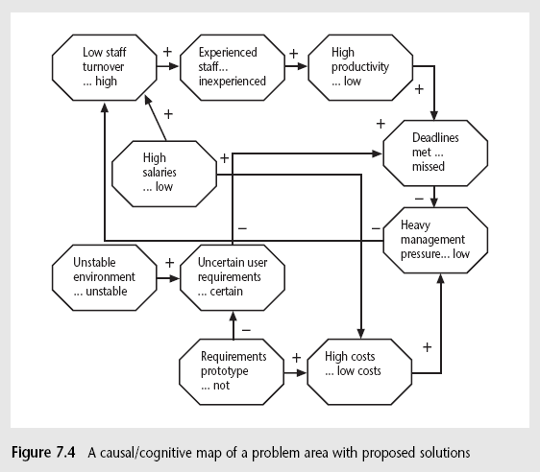
Causal mapping - interventions
Notes:
Once a causal map has been drawn up identifying possible negative outcomes and their causes, the map can be modified to introduce policies or interventions which should reduce or mitigate the effects of the negative outcomes.
Often a risk reduction activity can actually introduce new risks. The use of consultants to offset the effects of skill shortages is an example of this. Causal mapping can help identify such adverse side-effects.

Slide 23
Risk prioritization
Risk exposure (RE) = (potential damage) x (probability of occurrence)
Ideally
Potential damage: a money value e.g. a flood would cause $0.5 millions of damage
Probability 0.00 (absolutely no chance) to 1.00 (absolutely certain) e.g. 0.01 (one in hundred chance)
RE = $0.5m x 0.01 = $5,000
analogous to the amount needed for an insurance premium
Notes:
If there were 100 people chipping in $5,000 each, there would be enough for the 1 in 100 chance of the flooding. If there were 2 floods then the system collapses!
In practice, with project risks, these quantitative approaches are usually impractical and more qualitative approaches are used instead. See the next slide.

Slide 24
Risk Exposure: Example
Ref | Hazard | Likelihood | Impact | Risk Exposure
R1 | Changes to requirements specification during coding | 8 | 8 | 64
R2 | Specification takes longer than expected | 3 | 7 | 21
R3 | Significant staff sickness affecting critical path activities | 5 | 7 | 35
R4 | Significant staff sickness affecting non-critical activities | 10 | 3 | 30
R5 | Module coding takes longer than expected | 4 | 5 | 20
R6 | Module testing demonstrates errors or deficiencies in design | 4 | 8 | 32

Slide 25
Risk probability: qualitative descriptors
Probability level | Range
High | Greater than 50% chance of happening
Significant | 30-50% chance of happening
Moderate | 10-29% chance of happening
Low | Less than 10% chance of happening
Notes:
Managers would be happier identifying an approximate range rather than a precise probability.

Slide 26
Qualitative descriptors of impact on cost and associated range values
Impact level | Range
High | Greater than 30% above budgeted expenditure
Significant | 20 to 29% above budgeted expenditure
Moderate | 10 to 19% above budgeted expenditure
Low | Within 10% of budgeted expenditure.
Notes:
Similar tables can be produced for the impact on project duration and on the quality of project deliverables.
The problem with the qualitative approach is how do you combine the judgements about probability and impact – you can’t multiply them together.

Slide 27
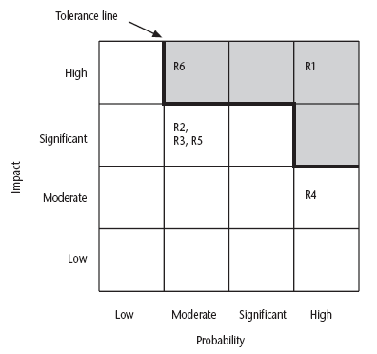
Probability impact matrix
Notes:
R1, R2 etc refer to particular risks. They are located on the grid according to the likelihood and impact ratings that have been allocated to them. A zone around the top right hand corner of the grid can be designated and risks falling within that zone are treated as requiring urgent action.

Slide 28
Risk planning
Risks can be dealt with by:
Risk acceptance
Risk avoidance
Risk reduction
Risk transfer
Risk mitigation/contingency measures
Notes:
Risk acceptance – the cost of avoiding the risk may be greater than the actual cost of the damage that might be inflicted
Risk avoidance – avoid the environment in which the risk occurs e.g. buying an OTS application would avoid a lot of the risks associated with software development e.g. poor estimates of effort.
Risk reduction – the risk is accepted but actions are taken to reduce its likelihood e.g. prototypes ought to reduce the risk of incorrect requirements
Risk transfer – the risk is transferred to another person or organization. The risk of incorrect development estimates can be transferred by negotiating a fixed price contract with an outside software supplier.
Risk mitigation – tries to reduce the impact if the risk does occur e.g. taking backups to allow rapid recovery in the case of data corruption

Slide 29
Risk reduction leverage
Risk reduction leverage (RRL)
= (RE_{before}- RE_{after})/ (cost of risk reduction)
RE_{before}is risk exposure before risk reduction e.g. 1% chance of a fire causing $200k damage
RE_{after} is risk exposure after risk reduction e.g. fire alarm costing $500 reduces probability of fire damage to 0.5%
RRL = (1% of $200k)-(0.5% of $200k)/$500 = 2
RRL > 1.00 therefore worth doing
Notes:
If you think in terms of the analogy to insurance. An insurance company might reduce the fire insurance premium from $2k to $1k on condition that a fire alarm is installed. The insured would save $1k a year by investing $500 so it would be worth doing.

Slide 30
Risk Due to Product Size
Product Attributes that affect risk:
• estimated size of the product in LOC or FP?
• estimated size of product in number of programs, files and transactions?
• percentage deviation in size of product from average of previous products?
• size of database created or used by the product?
• number of users of the product?
• number of projected changes to the requirements for the product? before delivery? after delivery?
• amount of reused software?

Slide 31
Risk Due to Business Impact
Attributes that affect risk:
• effect of this product on company revenue?
• visibility of this product by senior management?
• reasonableness of delivery deadline?
• number of customers who will use this product
• interoperability constraints
• sophistication of end users?
• amount and quality of product documentation that
must be produced and delivered to the customer?
• governmental constraints
• costs associated with late delivery?
• costs associated with a defective product?

Slide 32
Risks Due to the Customer
Questions that must be answered:
• Have you worked with the customer in the past?
• Does the customer have a solid idea of requirements?
• Has the customer agreed to spend time with you?
• Is the customer willing to participate in reviews?
• Is the customer technically sophisticated?
• Is the customer willing to let your people do their
job—that is, will the customer resist looking over your
shoulder during technically detailed work?
• Does the customer understand the software
engineering process?

Slide 33
Risks Due to Process Maturity
Questions that must be answered:
• Have you established a common process framework?
• Is it followed by project teams?
• Do you have management support for software engineering
• Do you have a proactive approach to SQA?
• Do you conduct formal technical reviews?
• Are CASE tools used for analysis, design and testing?
• Are the tools integrated with one another?
• Have document formats been established?

Slide 34
Technology Risks
Questions that must be answered:
• Is the technology new to your organization?
• Are new algorithms, I/O technology required?
• Is new or unproven hardware involved?
• Does the application interface with new software?
• Is a specialized user interface required?
• Is the application radically different?
• Are you using new software engineering methods?
• Are you using unconventional software development
methods, such as formal methods, AI-based approaches,
artificial neural networks?
• Are there significant performance constraints?
• Is there doubt the functionality requested is "do-able?"

Slide 35
Risk Management: In short…
Risk Management = Project Management!
Be proactive, anticipative
Little ‘pessimism’ helps!
Unanticipated risks? – escalate, escalate!
SS ZG622: Software Project Management – KG Krishna

Slide 36
Thank You
Any Questions?

